Slide 2

Monday we are looking at Sphere’s and Cubes
Click the sphere!

Slide 3


Examples of a Sphere
oranges
Earth
Can you find different things are around the house that are spheres?
next

Slide 4

Cube
Click the cube!

Slide 5


Examples of Cube’s.
dice
presents
Can you find different things are around the house that are cubes?
next

Slide 6
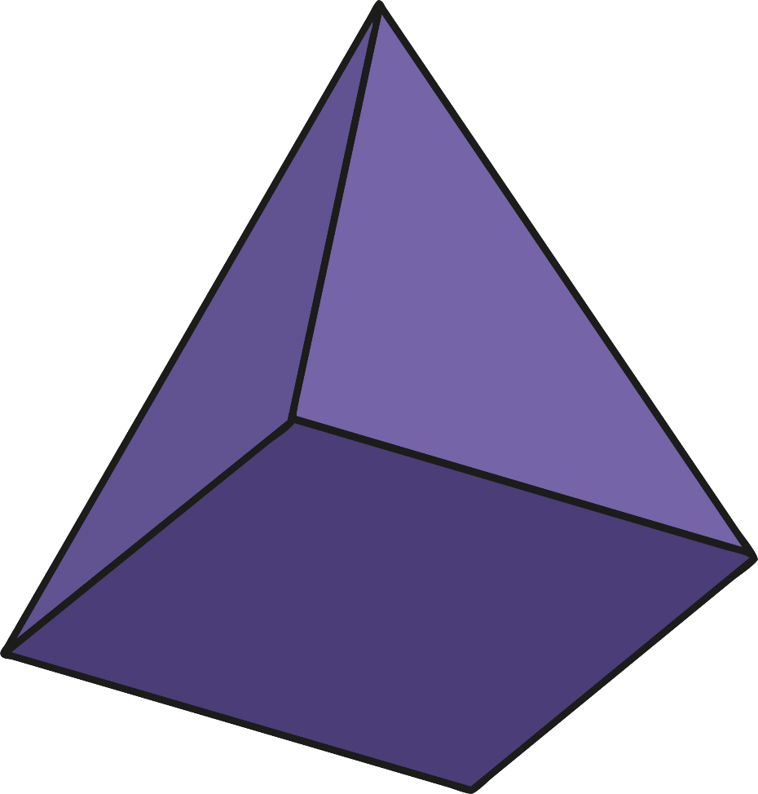
Tuesday we are looking at Pyramid’s.
Click the pyramid!

Slide 7
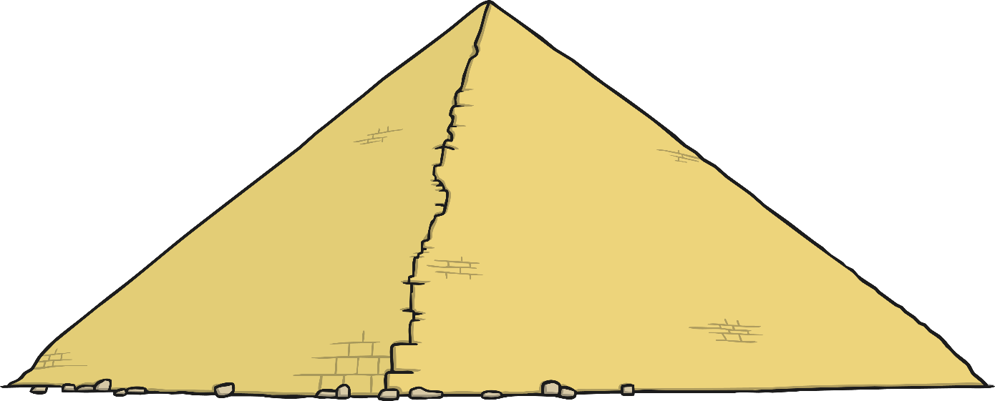
Pyramid
Egyptian pyramids
Can you find different things are around the house that are Pyramids?
next

Slide 8
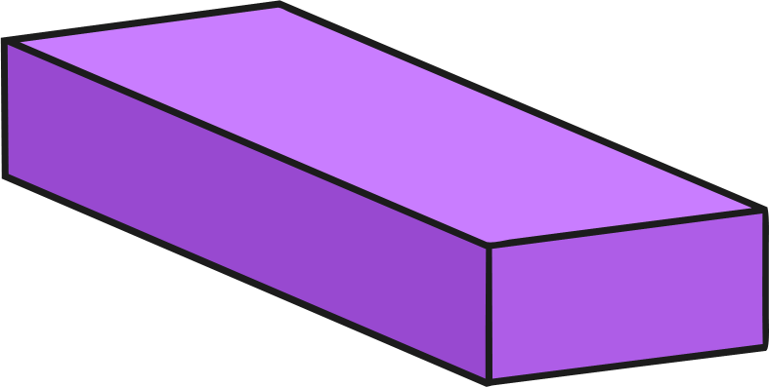
Wednesday we are looking at Cuboid’s.
Click the cuboid!

Slide 9

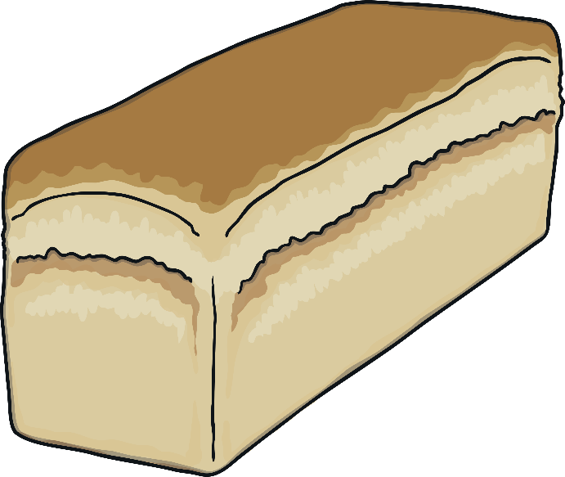
Examples of Cuboid’s.
cereal
loaf of bread
Can you find different things are around the house that are cuboid’s?
next

Slide 10

Thursday we are looking at Cylinder’s.
Click the cylinder!

Slide 11
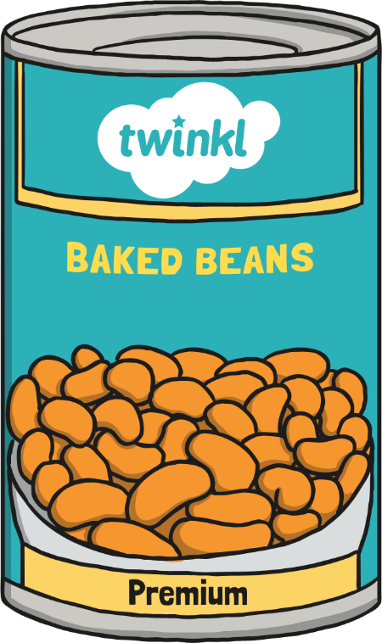

Examples of Cylinder’s.
tin can
toilet roll tube
Can you find different things are around the house that are cylinder’s?
next

Slide 12
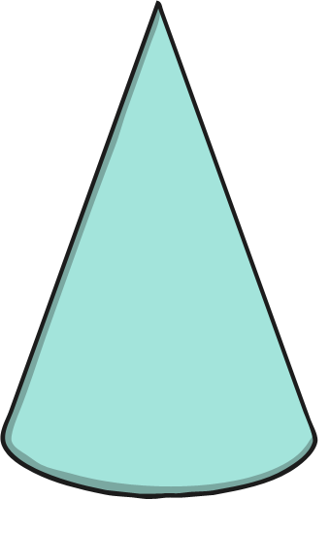
Friday we are looking at Cone’s.
Click the cone!

Slide 13


Examples of Cone’s
traffic cone
ice cream cone
Can you find different things are around the house that are cone’s?
next

