Slide 1


Year 2 SATS Meeting
January 2020

Slide 2

What will talk about this evening?
What are SATs?
An outline of the tasks and tests.
What you can do to help?
An opportunity to answer your questions.

Slide 3

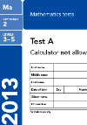
What are SATs?
SATs = Standard Assessment Tasks
KS1 SATs papers are taken by pupils in Year 2 as part of the National Curriculum assessment programme.
SATs tests inform Teacher Assessments

Slide 4
What are SATs?
Children are assessed in;
Reading
English
SPAG – Spelling, punctuation and grammar
In KS1 the emphasis is on teacher assessment, the tests support this judgement.

Slide 5
Teacher Assessment
Pupils will be made to feel as prepared and comfortable as possible.
No pressure just encouragement to do their best.
If children do not perform to their best ability in the test, teacher assessment can be used to support the judgement made.

Slide 6
Tasks and Tests
English | Maths
2x 30 minute Reading paper. 3 x 20 minute spelling, punctuation and grammar tests. (Non statutory) | 15 minutes Arithmetic test. 35 minutes Maths test focussing on fluency, problem-solving and reasoning.
These times are a guideline.

Slide 7
Tasks and Tests
English
Writing- Teacher assessment throughout the year. Speaking and listening- Teacher assessments throughout the year.

Slide 8




Reading
Children will complete two papers:
The texts will cover a range of fiction, non-fiction and poetry
Paper 1 consists of a selection of texts, with questions.
Paper 2 comprises of a longer reading booklet and a separate answer booklet

Slide 9
Reading questions
There will be a variety of question types:
Multiple choice – Have options of answers
Ranking/ordering -Number the events below in order
Matching –Match the character to the job that they do in the story’
Labelling -Label parts of the text
Find and copy -Find and copy one word that shows what the weather was like in the story’
Short answer - ‘What does the bear eat?’
Open-ended answer -‘Why did Lucy write the letter to her grandmother? Give two reasons.’

Slide 10
Ants are insects that you can often see in a garden, in a park or just on the pavement. They usually live underground. The Queen ant spends all day laying her eggs.
What kind of animal is an ant? ______
2. Find and copy two places you might see ants? ___________ ___________
3. What does the queen ant do?
Keeps her nest clean lays eggs

Slide 11
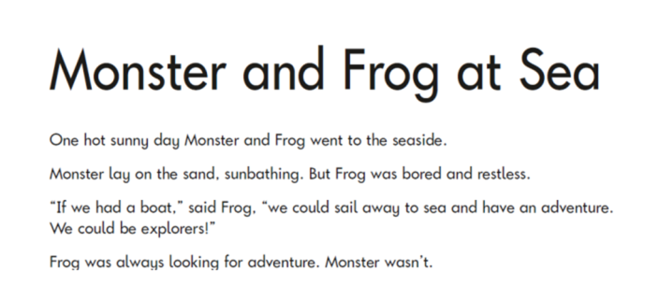
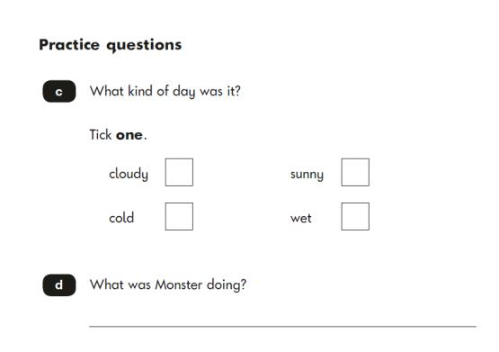
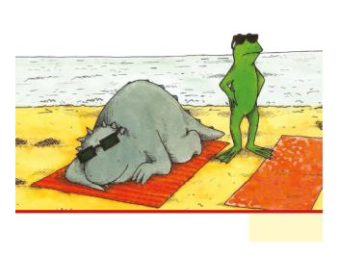

Slide 12

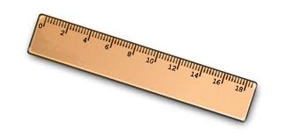
Mathematics
Mathematics SATs consist of;
Arithmetic test (15 minutes)
This will focus on the four main calculations.
Mathematical fluency, problem-solving and reasoning test (35 minutes)
Variety of question types:
multiple choice
matching
true/false
Constrained (giving an answer, drawing a shape, filling in a table)

Slide 13




Slide 14
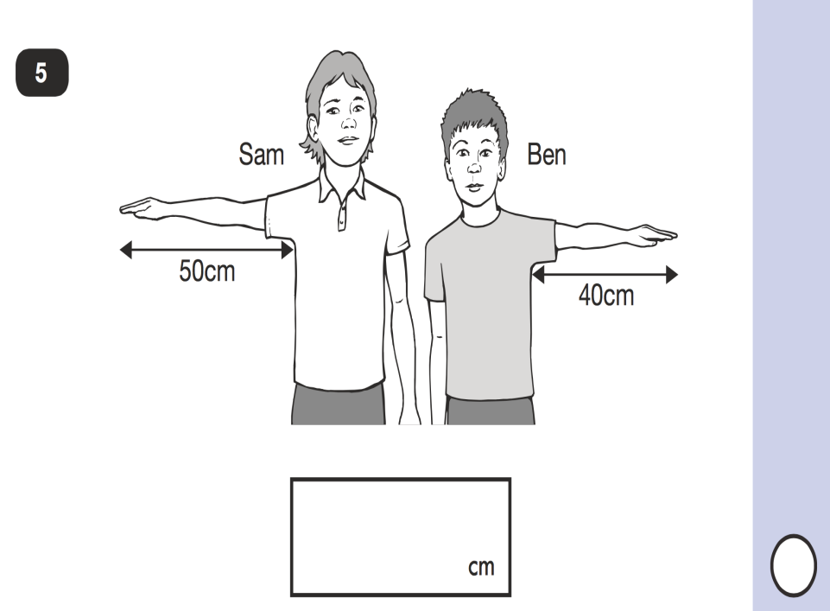

Slide 15
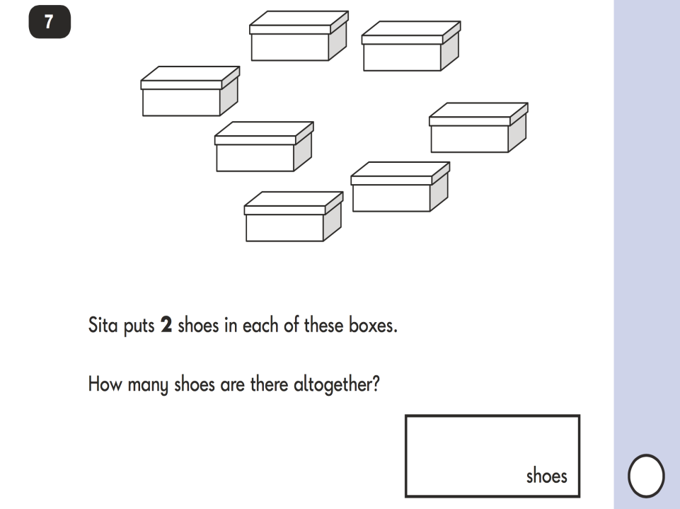

Slide 16
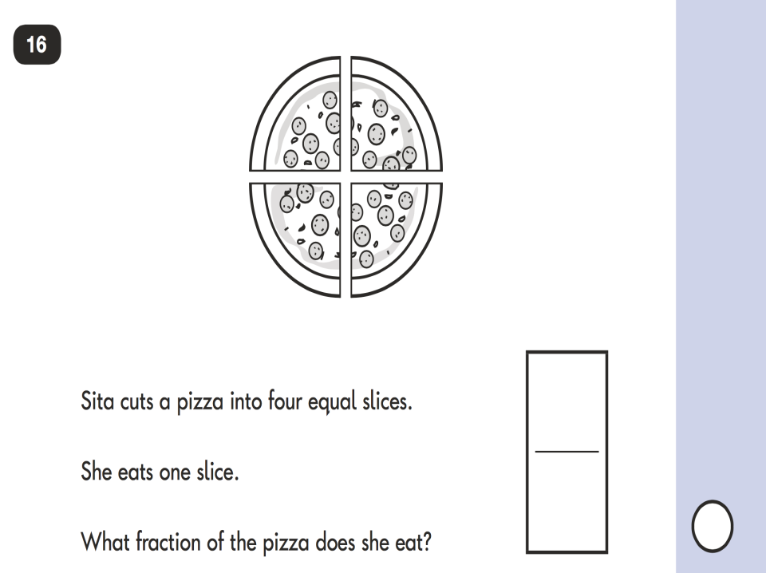

Slide 17

Homework
The Year 2 children are set Maths, English and Spelling homework every Monday. In addition to this they may be set a topic homework from time to time. Homework is to be returned to their teacher on the following Monday.
Also, we ask that you sign your child’s reading record every time you read with your child to show that they have read.

Slide 18

How can parents help?
The best help you can give is to show an interest in their learning and progress.
Supporting homework.
Good communication between the school and home.
Getting a enough sleep on a school night!
100% attendance as far as possible.

Slide 19

How can I
help with English?
Encouraging your child to read a variety of texts – the more they read, the more familiar they become with different text types.
Question them about what they are reading. Did they enjoy it? Why?
Spelling – spelling lists/rules every week

Slide 20
How can I help
with reading?
Encourage your child to read to you and you to read to them every night.
Encourage them to read fiction and non-fiction.
Sharing books with siblings
Reading homework

Slide 21
How can I help
with reading?
Try to listen to your child read and ask questions about what they are reading.
Help them with the different skills of reading especially ‘skim’ reading where they are looking for key words in the text.
Encourage child to talk about any new vocabulary they come across. Do they know what it means, how can they find out?
Retrieval – find vital pieces of information within a piece of text to answer questions
Sequencing events within a piece of text or book.

Slide 22
How can I help with Maths?
Support with homework – not just helping with the Maths. Get your child into the habit of reading the question, underlining the important parts that are going to help them.
Help your child to check their work through – this will help them to spot mistakes that can sometimes be easily fixed.

Slide 23
How can I help with Maths?
Times Tables (2,5,10 and 3)
Number Bonds to 20, 30 and 100
Counting forwards and backwards in 1s, 2s, 3s, 5s, 10s, 100s (from any given number)
Addition and subtraction using 2 digits

Slide 24
What can you do to help?
Maths
Times tables must be known.
Estimating, weighing, measuring are all good to discuss and do practically. Must use metric measures.
Money – using it in the shops, working out change, adding up bills, questions e.g. if 1 bag of sugar costs 60p, how much change will I get from a pound.
Mental addition, subtraction, basic multiplication & division
Reading and writing numbers to 100+
Doubling and halving,
Solving number puzzles

Slide 25
Useful Websites
www.topmarks.co.uk
www.bbc.co.uk/bitesize/ks1/
http://www.ictgames.com/resources.html
www.phonicsplay.co.uk
www.purplemash.com

