Slide 1

Brentside Primary Academy
KS2 SATs
Parent’s information meeting.

Slide 2
Key dates
Date | Assessment test
Monday 11th May | English grammar, punctuation and spelling Paper 1 – questions (45 minutes) Paper 2 – spelling
Tuesday 12th May | English reading test (1 hour)
Wednesday 13th May | Mathematics paper 1 – arithmetic (30 minutes) Mathematics paper 2 – reasoning (40 minutes) (pupils will have a short break between these tests)
Thursday 14th May | Mathematics paper 3 – reasoning (40 minutes)
All tests are sent away to be externally marked.
Writing is assessed by the class teachers and then reported both to parents and the DfE
Biannually, schools are selected at random to complete a science test, with only five children from the year group to complete them. We will notify parents of children involved if we are selected. However, results are only reported in terms of national data and so the school will not receive individual test scores.

Slide 3
Grammar and spelling
A spelling test is administered containing 20 words, which lasts approximately 15 minutes.
A separate test is given on grammar, punctuation and vocabulary.
This test lasts for 45 minutes and requires short answer questions including some multiple choice.
Marks for these two tests are added together to give a total for grammar, punctuation and spelling.

Slide 4
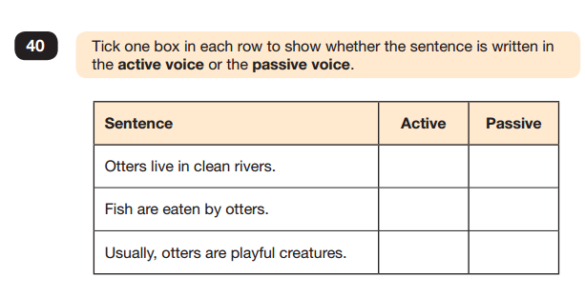

Slide 5
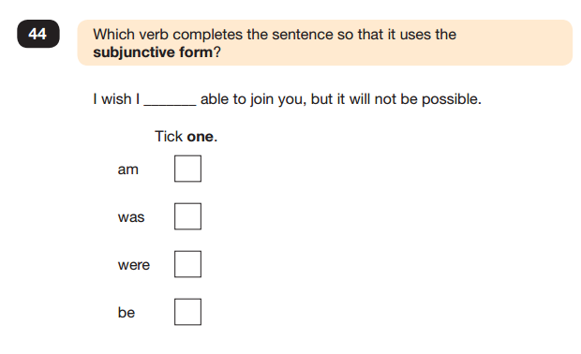

Slide 6
Reading
The reading test consists of a single test paper with three unrelated reading texts. Children are given 60 minutes in total, which includes reading the texts and answering the questions.
A total of 50 marks are available.
Questions are designed to assess the comprehension and understanding of a child’s reading.
During the reading paper, a child’s inference and deduction skills are thoroughly tested. They will also be expected to answer questions on authorial choices: explaining why an author has chosen to use particular vocabulary, grammar and text features.
Some questions are multiple choice or selected response; others require short answers and some require an extended response or explanation.

Slide 7
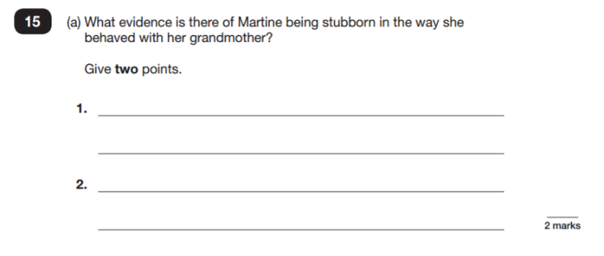

Slide 8
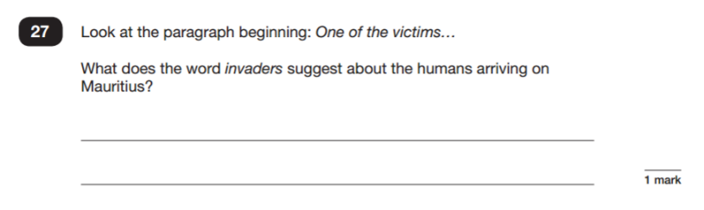

Slide 9
Mathematics
Children will sit three tests: paper 1, paper 2 and paper 3.
Paper 1 is for arithmetic lasting for 30 minutes, covering calculation methods for all operations, including use of fractions, percentages and decimals.
Questions gradually increase in difficulty. Not all children will be expected to access some of the more difficult questions later in the paper.
Papers 2 and 3 cover problem solving and reasoning, each lasting for 40 minutes.
Pupils will still require calculation skills but will need to answer questions in context and decide what is required to find a solution.

Slide 10
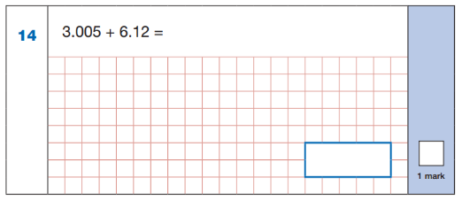
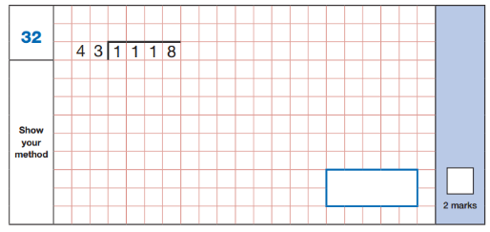

Slide 11
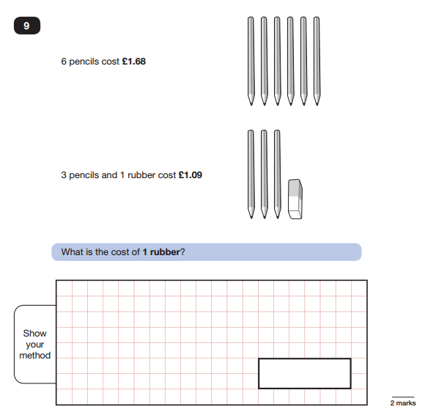

Slide 12
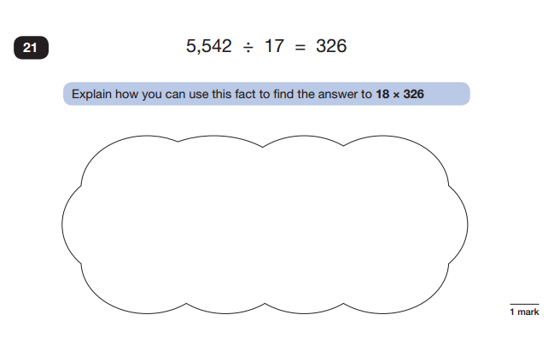

Slide 13
Assessment and reporting
As of 2014, the ‘old’ national curriculum levels (e.g. level 3, 4, 5) were abolished as set out in government guidelines.
The 2014 curriculum is rigorous and sets noticeably higher expectations than previous curricula, which is why all schools have had to work hard to meet and adapt to it since its introduction.
Since 2016, test scores have been reported as ‘scaled scores’.

Slide 14
Scaled scores
What is meant by ‘scaled scores’?
100 will always represent the ‘national standard’.
Each pupil’s raw test score will therefore be converted into a score on the scale, either at, above or below 100. The raw scores needed to gain 100 differ from year to year dependent on the national acheivement.
Using the scaled score, the lowest a child can score is 80, with the highest being 120.
A child who achieves the ‘national standard’ (a score of 100) will be judged to have demonstrated sufficient knowledge in the areas assessed by the tests.
Each pupil receives:
a raw score (number of raw marks awarded);
a scaled score in each tested subject;
confirmation of whether or not they attained the national standard.

Slide 15
On publication of the test results in July:
a child awarded a scaled score of 100 is judged to have met the ‘national standard’ in the area judged by the test;
If a child’s score is close to 120 (usually around 110 but will be determined nearer the time, they are working beyond (or above) the expected national standard.
a child’s score is close to 80, they are judged to have not yet met the national standard and per- formed below the expectation for their age.

Slide 16
Higher attainment
In the past, Key Stage 2 tests were aimed at children achieving levels 3-5 (with a national expectation to reach at least level 4).
This meant that additional level 6 tests were produced for children who demonstrated higher than expected attainment (above level 5).
Under the new system, there are not any separate tests for the most-able children.
Instead, each test will have scope for higher-attaining pupils to show their strengths.
This means that some questions towards the end of the tests may be more difficult for many children but they should be encouraged to attempt as much of the test as they are able to.

Slide 17
Preparation in school.
Children will have specialist teaching from the class teachers and assistant head teacher in English and Maths.
Specialist TAs and support teachers are working alongside the class teachers in most lessons.
Each child has been given their own revision guides and homework diaries to reinforce learning in school.
Every child has been invited to a before school booster club to support their particular needs.
Short intervention groups are taking place for children needing support in a particular area of learning but these will not take away from the wider curriculum.
Children are taking part in practice tests to get them prepared for the exams in May. Time is then spent working through the tests afterwards in class to address any misconceptions.

Slide 18
Supporting your child at home.
First and foremost, support and reassure your child that there is nothing to worry about and they should always just try their best. Praise and encourage!
Ensure your child has the best possible attendance at school.
Support your child with any homework tasks.
Reading, spelling and arithmetic (e.g. times tables) are always good to practise.
Talk to your child about what they have learnt at school and what book(s) they are reading (the character, the plot, their opinion) Guidance has been sent home with their reading book to help you with this and there is plenty of information for parents in the revision guides too.
Make sure your child has a good sleep and healthy breakfast every morning!

Slide 19
Reading support
Listening to your child read can take many forms.
First and foremost, focus developing an enjoyment and love of reading.
Enjoy stories together – reading stories to your child at KS1 and KS2 is equally as important as listening to your child read.
Read a little at a time but often, rather than rarely but for long periods of time!
Talk about the story before, during and afterwards – discuss the plot, the characters, their feelings and actions, how it makes you feel, predict what will happen and encourage your child to have their own opinions.
Look up definitions of words together – you could use a dictionary, the Internet or an app on a phone or tablet.
All reading is valuable – it doesn’t have to be just stories. Reading can involve anything: fiction, non-fiction, poetry, newspapers, magazines, football programmes and TV guides.
Visit the local library - it’s free!

Slide 20
Writing support
Practise and learn spelling lists – make it fun!
Encourage opportunities for writing such as letters to family or friends, shopping lists, notes or reminders, stories and poems.
Write together – be a good role model for writing.
Encourage use of a dictionary to check spelling and a thesaurus to find synonyms and expand vocabulary.
Allow your child to use a computer for word processing, which will allow for editing and correcting of errors without lots of crossing out.
Remember that good readers become good writers! Identify good writing features when reading (e.g. vocabulary, sentence structure and punctuation).
Show your appreciation: praise and encourage, even for small successes!

Slide 21
Mathematics support
Play times tables games.
Play mental maths games including counting in different amounts, forwards and backwards.
Encourage opportunities for telling the time.
Encourage opportunities for counting coins and money; finding amounts or calculating change when shopping.
Look for numbers on street signs, car registrations and anywhere else!
Look for examples of 2D and 3D shapes around the home.
Identify, weigh or measure quantities and amounts in the kitchen or in recipes.
Play games involving numbers or logic, such as dominoes, card games, darts, draughts and chess.

Slide 22
Any questions?

