Slide 1
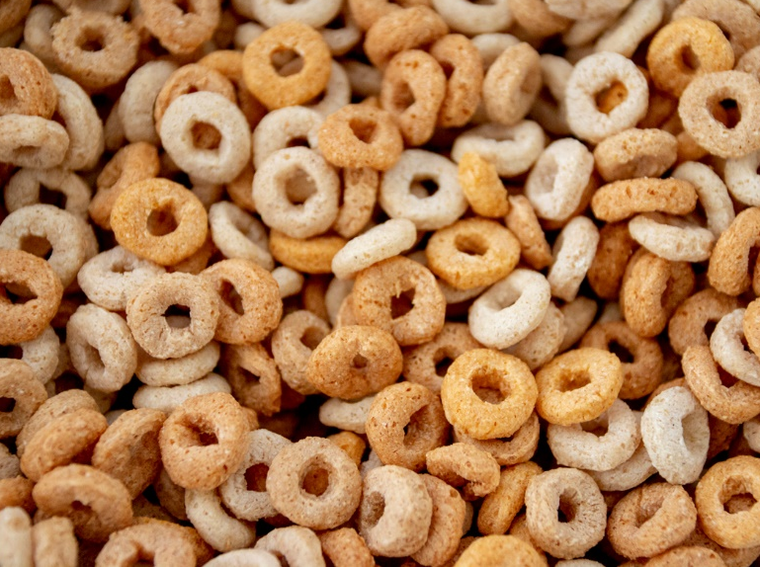
Who had breakfast this morning?
Notes:
Who likes breakfast? Hands up?

Slide 2
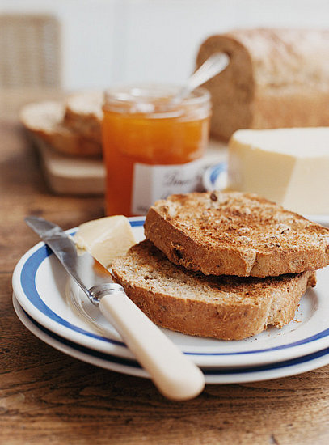
What is breakfast?
Breakfast is the first meal of the day for most people
The word ‘breakfast’ is shortened from ‘breaking fast’
‘Breaking fast’ means ending a time of not eating… (you were fasting while you were asleep!)
Notes:
We think of fasting usually for religious reasons, between certain times of day, but that all of us have a mini fast, every night which means your body and brain are low on energy and need refueling when you wake up.
Could talk about this not being true if you get up in the night for a midnight feast of course!

Slide 3
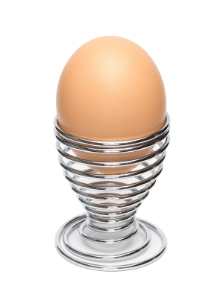
Why is breakfast important?
  Breakfast
  helps our bodies to wake up in the morning
  gives energy to our bodies and brains
  stops us feeling hungry before lunch
  helps us to think better and faster
  stops us feeling tired and grumpy
  can help us stay a healthy weight.
Notes:
So, ‘Why is breakfast important?’
Breakfast is the most important meal of the day, as it helps our bodies wake up and get going for the day ahead, by providing us with energy.
Eating breakfast also helps stop us from feeling hungry mid-morning/before lunch, and so helps prevent us from wanting to snacking on unhealthy food.
Breakfast has also been shown to help us concentrate at school or work, and stop us from feeling tired or moody.
Research says that eating breakfast in the morning helps people maintain a healthy weight. It’s all about eating the right food at the right time!

Slide 4
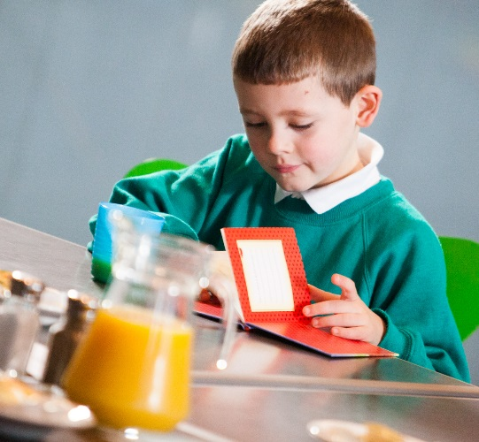
Breakfast is especially important for children!
Your brain needs energy for
you to think!
Your body needs energy for
you to run and play
Without the right fuel in
your tummy, it’s harder to
concentrate, to think clearly
in lessons and to be fast and strong in PE
Notes:
People with a lot going on in their brains, and who are very active, really need the right fuel in their bodies. A bit like a car can’t run without the right fuel, neither can your brain or your body.

Slide 5
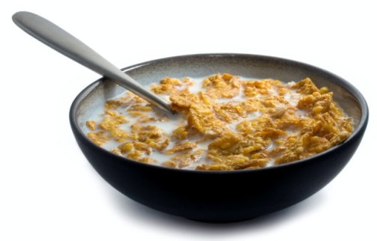
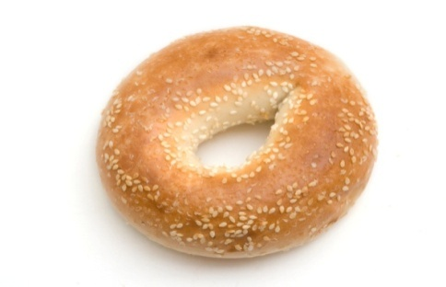
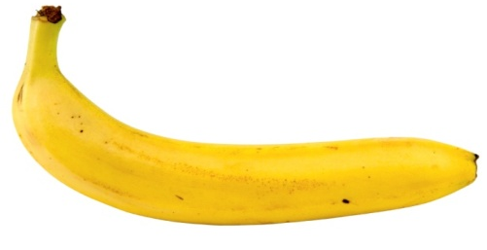
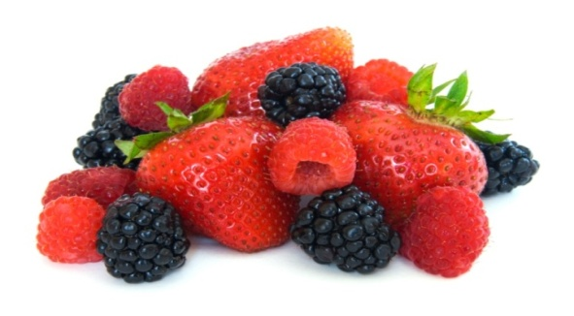
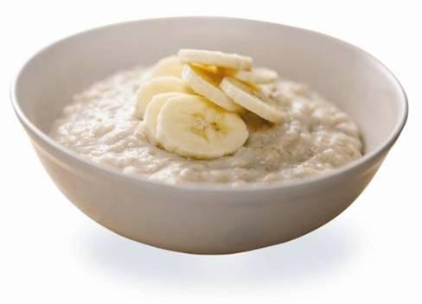

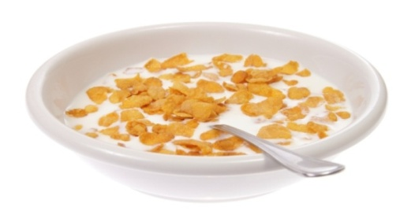
Here are some smarter choices…
Notes:
Here are some common breakfast foods.
Can you name them?
What is/are your favourite one(s)?
It can be hard to fit in enough portions of fruit and veg a day so it’s a good idea to fit one in at breakfast!
Eggs and beans are great at breakfast as they add in protein, which is good for growing bodies.
You might want to mention that if children are going to drink juice it should only be a small serving once a day, of 100% fresh fruit juice, and it should be diluted half and half with water. Whole fruit is better for teeth than fruit juice – even if the juice doesn’t have any added sugar in it.
Interactive option: Ask a child to pour out what they think is a serving of juice? (Answer = 150ml)
[For more info on 5-a-day portions: www.nhs.uk/live-well/eat-well/5-a-day-portion-sizes/]

Slide 6
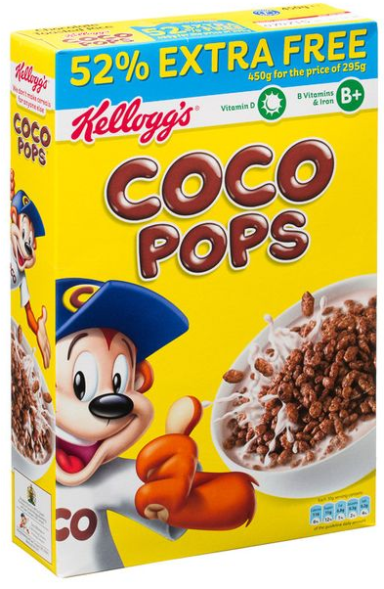

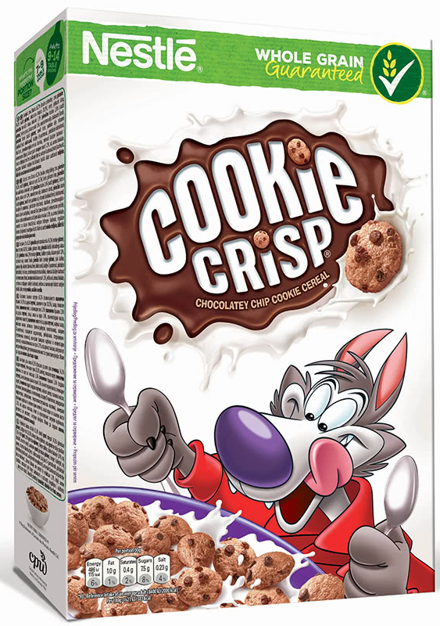
Beware sugary cereals!
Here are examples of breakfast cereals that are low in fibre and high in sugar. Anything covered in chocolate or sugar coated shouldn’t be eaten very often – definitely not every day!
Notes:
Did you know that schools are not allowed to give children cereals with chocolate on or in it, or cereals covered in sugar!
But why is it bad for you?
Most of us know that too much sugar can damage your teeth – rotten teeth can be very painful and might even need to be removed by surgeons in hospital.
But it isn’t just teeth - if you have too much sugar at the start of the day, you have too much energy in a big burst and want to run round and be silly when you should be settling down to work, and then suddenly all the sugar has been used up and you then slump right in the middle of lessons – your brain has no fuel to think and you feel grumpy and tired.
Instead we need less sugar and more ‘slow release’ energy that you get from wholegrain and – best of all – porridge!
Interactive: could ask a child to measure out of a bag of sugar into a typical cereal bowl how many teaspoons are in a serving of sugary cereal
Look at the information panel on the cereal box. Sugary cereals often have as much as 11g of sugar in 30g serving. 11g sugar = 2 ¾ teaspoons. This looks a lot in a small bowl!
NB Make sure you check the packaging for the right amount of sugar, as the cereals can change in formulation.

Slide 7
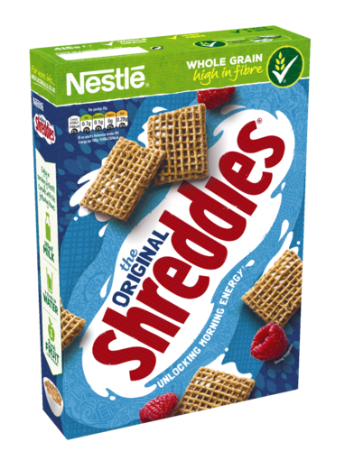
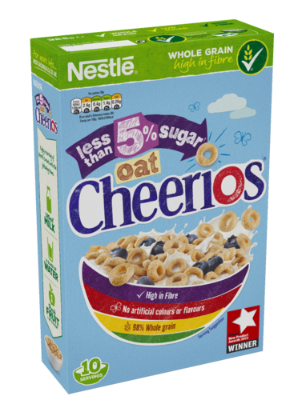

Lower sugar breakfast cereals
For everyday breakfast, choose breakfast cereals that are:
  low in sugar
  higher in wholegrain
Notes:
It’s very important to choose cereals low in sugar. You can see how much sugar is in a packet of cereals by looking on the side of he box. Look for cereal with 15g or less of sugar in 100g of cereal, or under 10g is even better!
Look on cereal packets for the word ‘whole’ for wholegrain or wholewheat. This means that the grains used in the ingredients are less processed (more like the plant they grow on) and so contain more of the fibre, which helps keep your tummy fuller for longer. It also helps you go to the toilet (no 2’s!) more regularly.

Slide 8
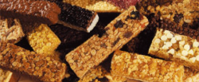
Cereal bars
Cereal bars are not smart choices because they are usually full of sugar and fat. The sugar and fat is used to thicken the ingredients to become solid.
It’s better to have a bowl of cereal – even better with fruit!

Slide 9

So remember…
  Don’t miss breakfast – eat it every
  day!
  Make smarter choices for your health
  - not biscuits
  - or crisps
  - or sweet drinks!
  Have different food groups – like
  cereal with milk or bagel with a
  banana
  Why not come and have breakfast
  at school with your friends?
Notes:
Always have something for breakfast – either at home or at school.
Make smarter choices – not sugary ones! Give your body the right fuel to make it work best.

Slide 10
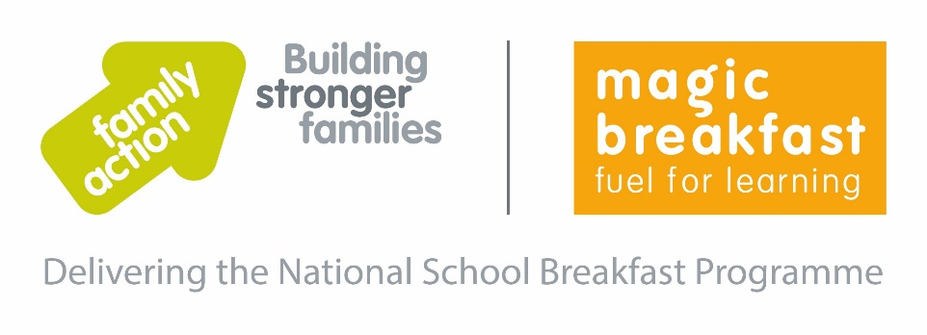
Have you tried a ‘magic’ school breakfast?
Our school is proud to be part of the National School Breakfast Programme, making sure every child has the right fuel for learning!
Notes:
Talk about your school breakfast.
Thousands of children around the country are joining us in getting the right fuel for learning. Why not join us?

