Slide 1



Why do we have t eeth?

Slide 2
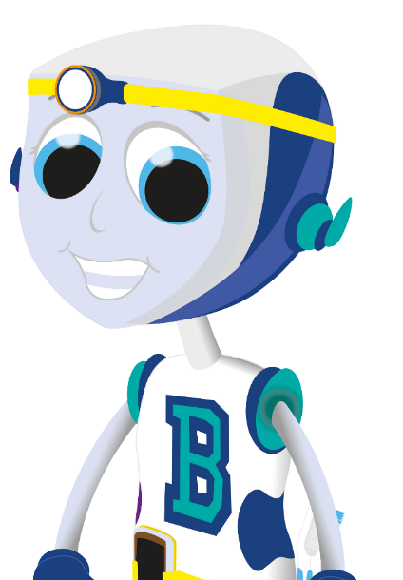
Our teeth are special, we need them to help us
do many things.
What do we need our teeth for?
© Oral Health Foundation www.dentalhealth.org

Slide 3

W e need our teeth to eat W e need our teeth to smile W e need our teeth to talk
© Oral Health Foundation www.dentalhealth.org

Slide 4
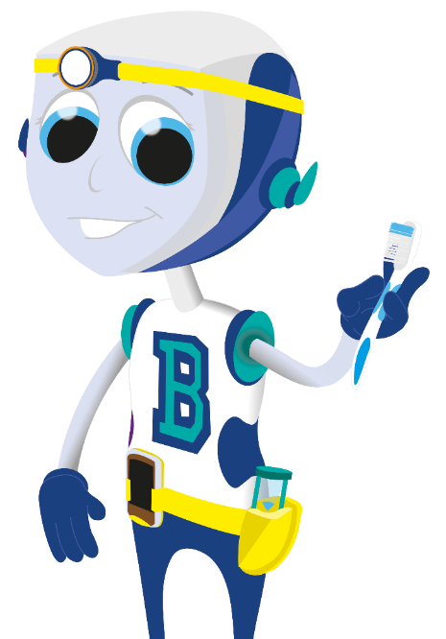
How many teeth do you have?
© Oral Health Foundation www.dentalhealth.org

Slide 5

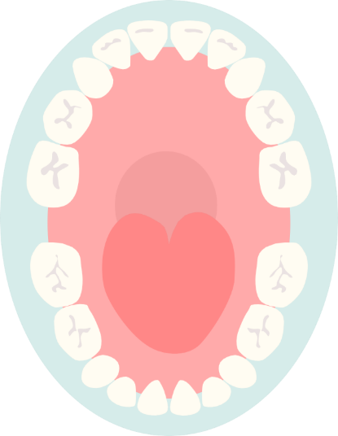
L et’s count together
© Oral Health Foundation www.dentalhealth.org

Slide 6

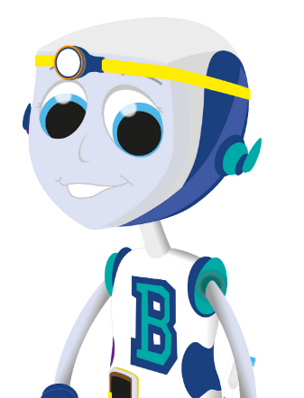
You should
h ave 20 t eeth
© Oral Health Foundation www.dentalhealth.org

Slide 7
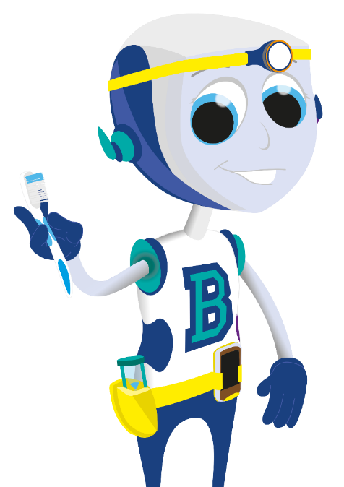
It’s important to look after these teeth
Do you know how we look after our teeth?
© Oral Health Foundation www.dentalhealth.org

Slide 8
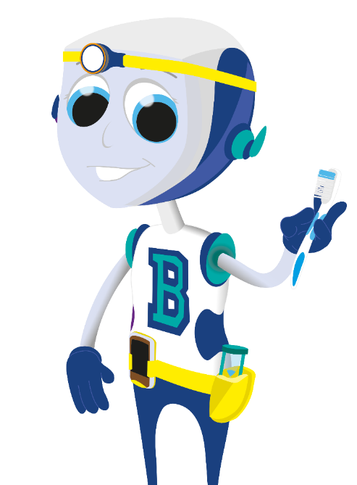
We should brush our teeth for two minutes, when we go to bed and one other time during the day.
© Oral Health Foundation www.dentalhealth.org

Slide 9
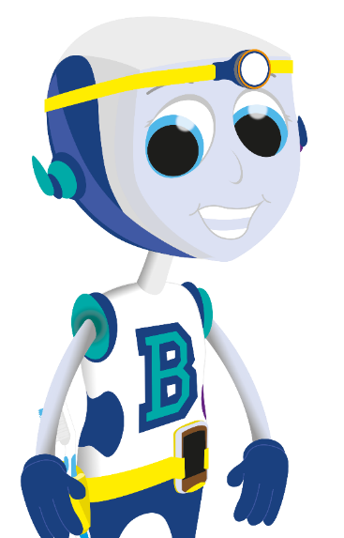
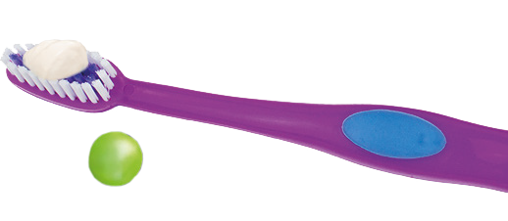
W e use a pea sized
amount of toothpaste
© Oral Health Foundation www.dentalhealth.org

Slide 10
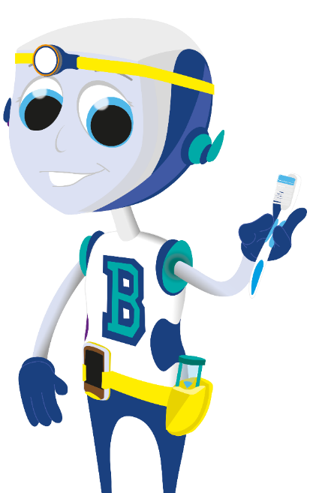
Then we brush every tooth, and the gumline too , making tin y circles with the toothbrush.
First brush the outside of the teeth, both top and
bo ttom
© Oral Health Foundation www.dentalhealth.org

Slide 11
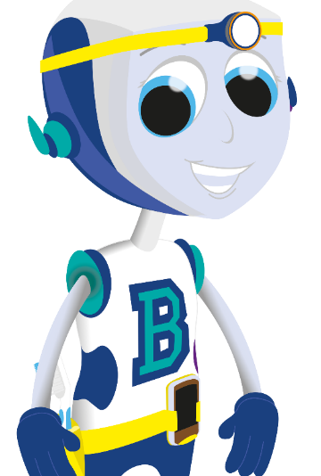
Brush the inside of
all the teeth and then the biting surface of every tooth.
It’s important that we take our time and make su re
we do it properly.
© Oral Health Foundation www.dentalhealth.org

Slide 12
Then spit out the toothpaste.
DON’T rinse your mouth, just your toothbrush
© Oral Health Foundation www.dentalhealth.org

Slide 13
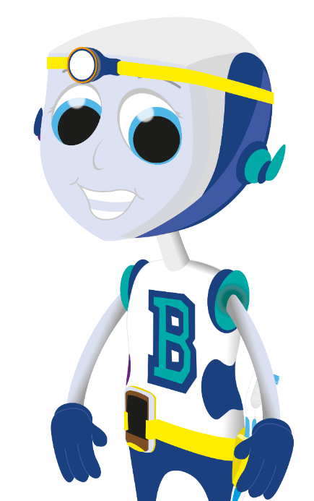


Well Done!
© Oral Health Foundation www.dentalhealth.org

