Slide 1
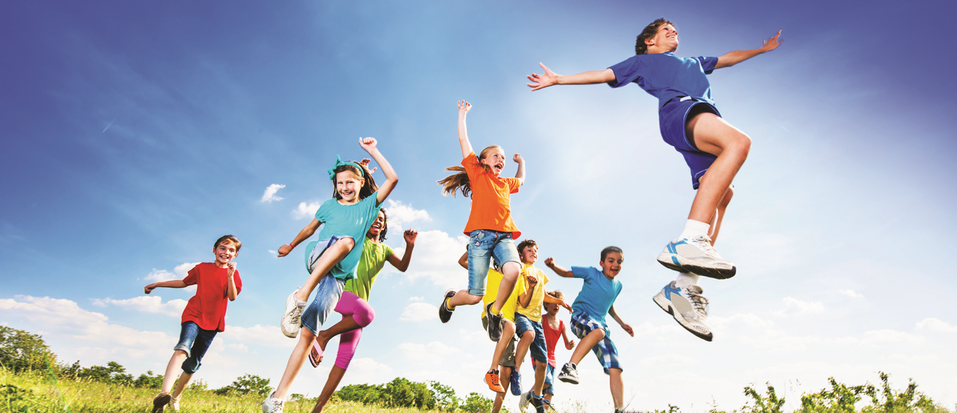


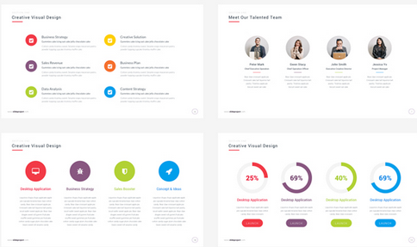
Health Partnership
Celebration event
Keeping children safe
Workshop 2
Health Improvement Team

Slide 2
Focus for today’s workshop:
Looking at the school’s safeguarding curriculum.
Finding out how the school teaches children to keep themselves safe

Slide 3




Slide 4
Part of the schools role is to ensure that your children leave school being able to read, write & to have mathematical skills that they will need for life.
But the biggest role is to ensure all children are safe and are empowered with the correct information of where to go and what to do if they are not.
Whether this be online safety, road safety or personal safety.
Keeping your child safe

Slide 5

What topics would you expect the school to teach about?

Slide 6
Drugs, alcohol and tobacco
Nutrition
Obesity
RSE
Equality
E-safety
Mental health and resilience
Stress and anxiety
Managing risks
Bullying and friendship
Safeguarding
Gender
Managing emotions
Prevent
Keeping safe
FGM
Social skills
Conflict resolution
Where to get help
poverty
charity
The needs of others
British Values
Rights and needs

Slide 7
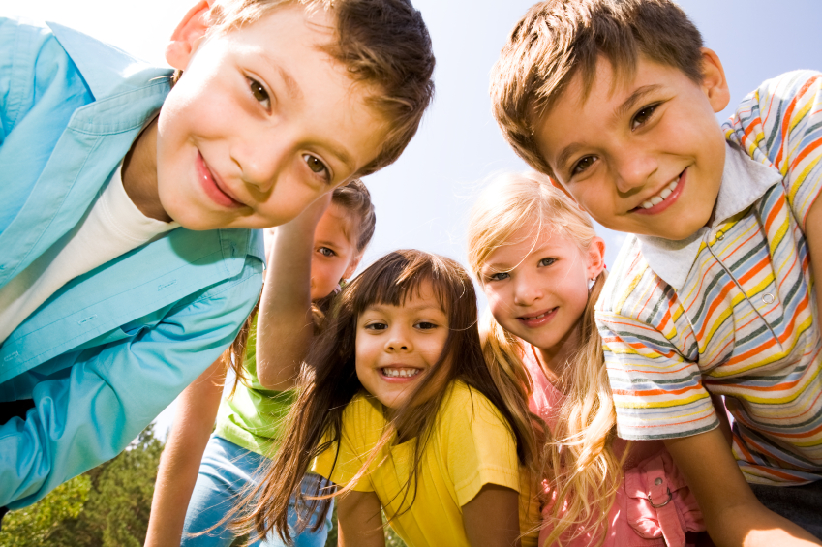
Why the scheme of work was developed
Notes:
The Ealing Primary School PSHE scheme of work was developed in 2017 by the Ealing Health Improvement Team and 6 local primary schools.
Headteachers and PSHE leads across Ealing reported that they felt that the existing PSHE scheme of work was no longer relevant and did not meet the needs of their pupils. They felt that more and more topics were being added on to an already overloaded PSHE curriculum, meaning that many topics were not being covered.

Slide 8



Three themes
Health and wellbeing
Living in the wider world
Relationships
Notes:
To begin with, the working party looked at the existing scheme of work and identified the topics they felt should remain in the new scheme. Then, as a group we listed all the topics we felt needed to be added to the new scheme of work.
We then mapped these topics across three themes:
Health and wellbeing. This theme explore healthy lifestyles including healthy eating, exercise and drugs, oral health and drugs, alcohol and tobacco education. During this theme children will also explore friendships linked to Anti Bullying week and will explore democracy and parliament linked to Student council elections. The year 5 Eat like a champ programme from Danone is embedded within this theme.
Living in the wider world: this theme explores the world around the children. It look at economic education including budgeting and value for money. It also explores gender stereotypes and encourages children to break the many stereotypes that exist. It looks at the water crisis around the world and teaches children about the differences between their wants and their needs. It teaches children about emigration and homelessness and breaks the stereotypes associated with both. Online safety is embedded within this theme.
Relationships: finally this theme focuses on different types of relations and what a healthy relationships is. RSE is embedded within this theme using the CWP resources. FGM also features within this theme.
It was decided that each school term would have a new theme. These three themes were chosen as they link to the PSHE Association guidance. Using this mapping, we created long and medium term plans that supported the new PSHE curriculum.

Slide 9
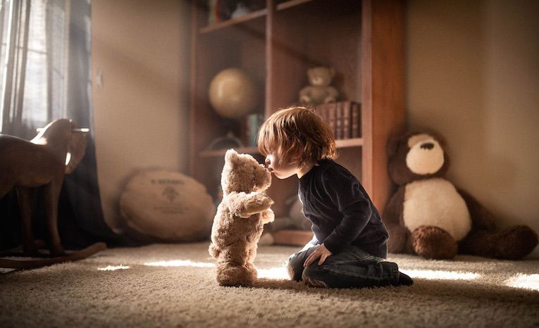
Safeguarding
Notes:
Each lesson begins with reference to British Values and with reference to the PANTS rule.
PANTS
RSE
FGM

Slide 10
Keeping clean and healthy
Oral health
Celebrating differences
Being kind to others
Learning how to play with other children
PANTS rule
Keeping safe online
Recognising and managing feelings
Appropriate and inappropriate touch
Early years

Slide 11
Keeping clean and oral health
Healthy lifestyles
Being safe around medicine and hazardous substances
Understanding harmful effects of smoking
Celebrating differences
Bullying and friendship
Conflict resolution
PANTS rule
Celebrating differences
Online safety – personal information and trust
Fire safety
Personal safety (home and school)
Good and bad secrets
Key Stage 1

Slide 12
Keeping clean and oral health
Healthy lifestyles
Legal and illegal drugs, alcohol education
Understanding harmful effects of smoking and caffeine
Celebrating differences
Bullying and friendship
Conflict resolution
PANTS rule
Online safety – digital footprint, lasting content
Water and road safety
Critical thinking – trusting everything you see online
Personal safety (home and school)
Good and bad secrets
Lower Key Stage 2

Slide 13
Keeping clean and oral health
Healthy lifestyles
Legal and illegal drugs, alcohol education, peer pressure
Understanding harmful effects of smoking and caffeine
Bullying and friendship
Conflict resolution
PANTS rule
Celebrating differences
Online safety – sharing content, peer pressure
Critical thinking – trusting everything you see online
Cycle safety
Risky behaviour
Upper Key Stage 2

Slide 14
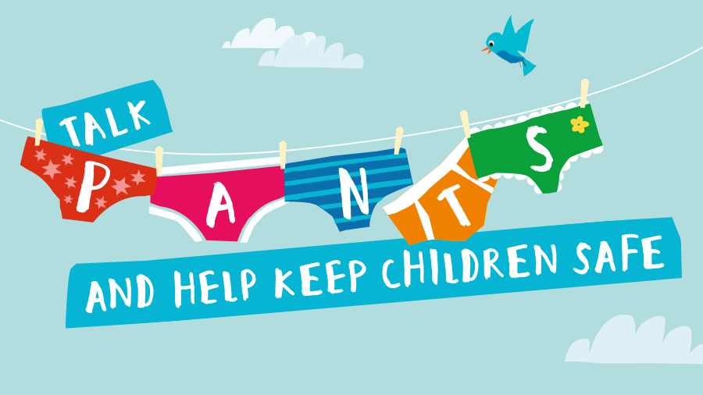

Slide 15
These events do not happen every day
But we do all need to be aware of the dangers so that we can protect all children.
We also need to teach our children how to keep themselves safe
Keeping your child safe

Slide 16
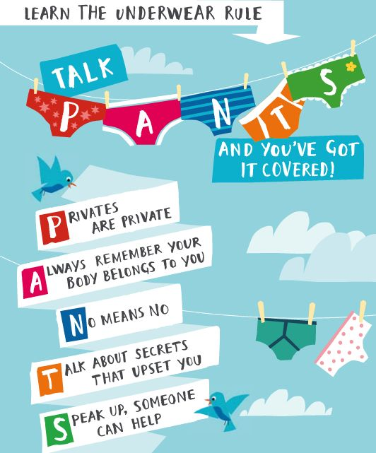

Slide 17

Will this be scary?

Slide 18

Who started the PANTS project?
They provide:
Lessons plans
Resources
Guidance
Training
So that we can deliver this important message to our children.

Slide 19
PANTS lessons for children
By the end of the lessons the children will be able to:
Understand the Underwear Rule and Talk PANTS
Name body parts and know which parts should be private
Know the difference between appropriate and inappropriate touch and understand that they have the right to say ‘no’ to unwanted touch – even to a family member or someone they know or love.
Start thinking about who they trust and who they can ask for help.

Slide 20

We will be sharing this slogan, My Body, My Rules.
It is crucial that children know they have rights over their body to keep themselves safe.
Recently we listen to the news and hear reports of historic & more recent cases of children being mistreated.

Slide 21
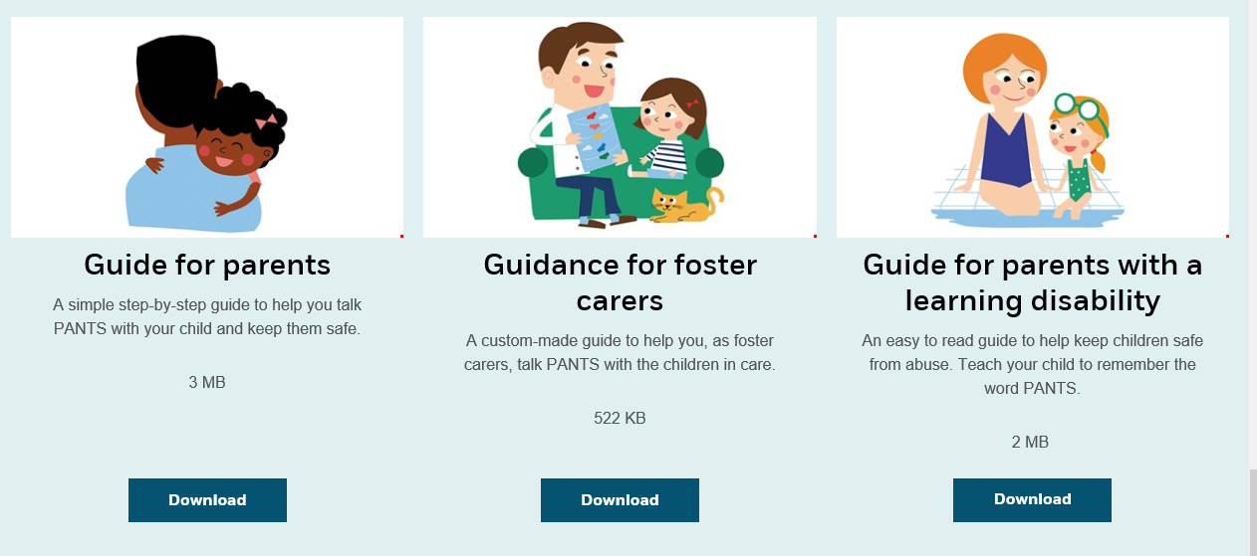
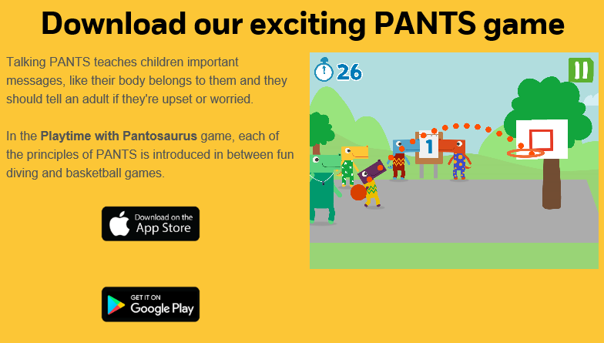
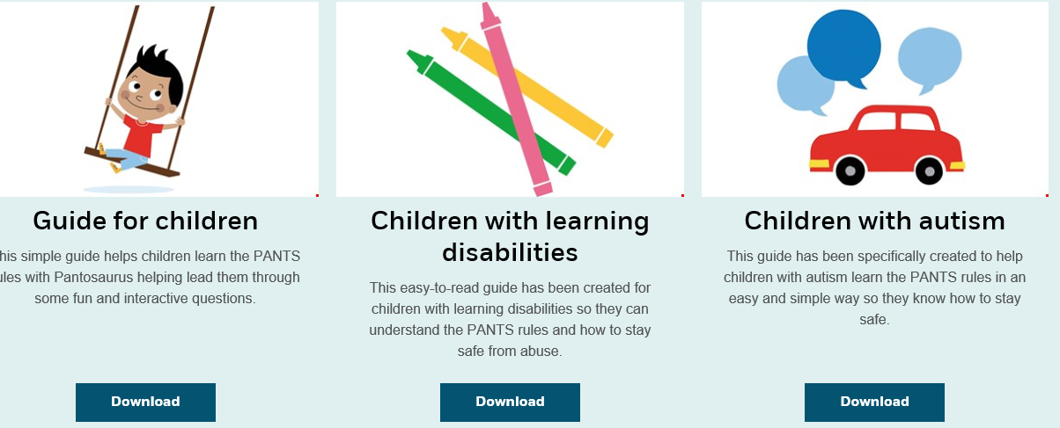
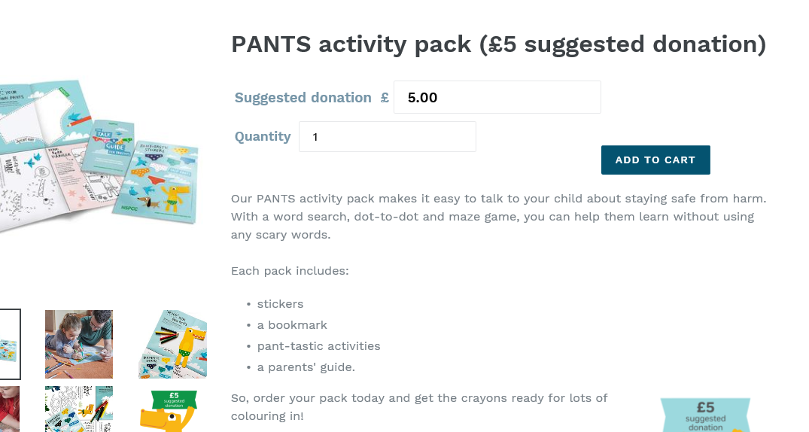
Support for parents
Notes:
Personal, Social and Health Education
Sex and Relationship Education

Slide 22
What would you say?
Is it “bad” to be naked?
Why would someone want to touch me under my pants?
Am I allowed to say “No” to a kiss or a hug from a family member or refuse to sit on their lap?
What if someone I know touches me?
Does it matter what colour my pants are?
Notes:
Personal, Social and Health Education
Sex and Relationship Education

Slide 23
Online safety
Social media
Gaming
Addiction to gaming
Next workshop: 19th May

Slide 24
Future dates
20th May
26th May

Slide 25

Questions

Slide 26







Thank you for attending!
Hoda Ali

