Slide 1



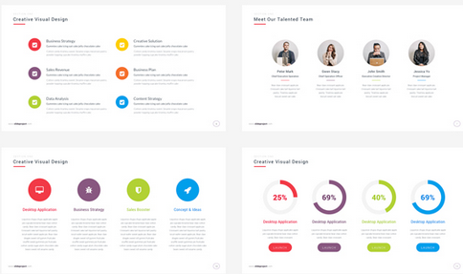
Health Partnership
Celebration event
Keeping children safe
Workshop 1
Health Improvement Team

Slide 2
Focus for today’s workshop:
Introduction to safeguarding
The school’s role and responsibility in relation to safeguarding
The school's procedure in relation to safeguarding
What safeguarding looks like in this school
What are we safeguarding children from?

Slide 3

What do you know about safeguarding in this school?

Slide 4
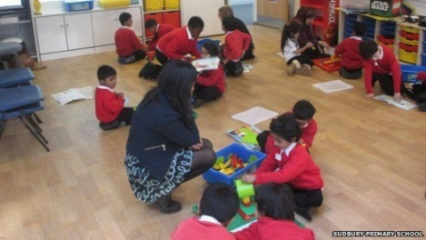
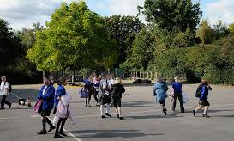
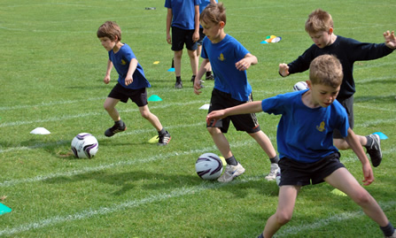
Keeping your children safe
The school has a ‘duty of care’ to keep your child/children safe.
They are required to take action if they feel that a child may not be safe.

Slide 5
What does safeguarding mean?
Safeguarding refers to the way a school keeps children safe.
Head teachers, teachers and all staff are required to take reasonable steps to reduce risk and are often referred to as: ‘in Loco Parentis’ which means in the place of a parent.

Slide 6
Keeping your children safe
Suitable and safe premises
Adequate supervision
Prevent and deal with bullying
Medical assistance
Managing staff recruitment, conduct and performance
Child Protection Procedures
Staff training
Relevant curriculum

Slide 7
How do we do this
Risk Assessments
Careful planning
FGM Act 2003
Relationships and Sex Education
School policies
Behaviour – including bullying
Health and safety – safe site
Safeguarding – child protection
Online safety – being safe online
Fire safety – emergency procedures
School safeguarding procedures and designated Staff

Slide 8
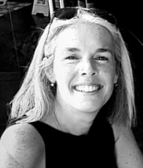
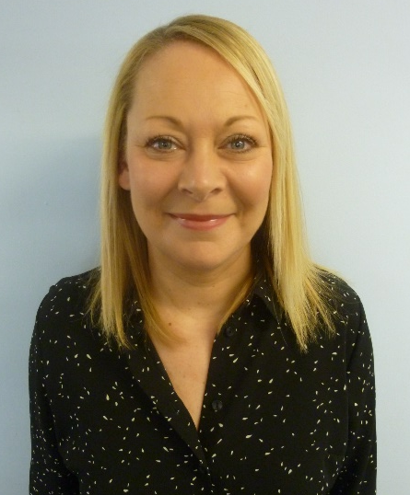
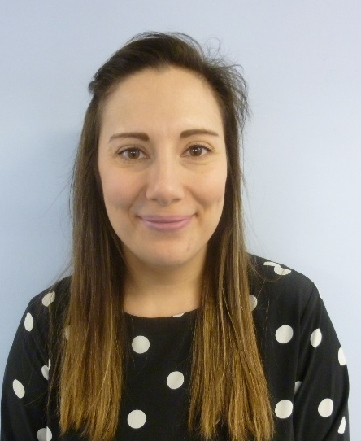
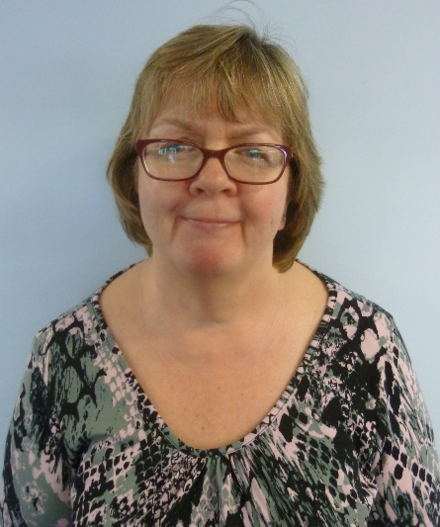
SAFEGUARDING
Designated Staff at Brentside Primary Academy

Slide 9
SAFEGUARDING
Designated Staff at Brentside Primary Academy
Caroline Crosdale - Designated Safeguarding Lead (DSL)
Jemima Smith - Deputy Safeguarding Lead (DDSL)
Sue Sobti - Deputy Safeguarding Lead (DDSL)
Ruth Shaw – Safeguarding Governor

Slide 10
What happens – school’s procedure
NOTICE
Concerns raised by child or member of staff
CHECK
Gentle conversations by designated/trained staff
Information collected from other staff members as appropriate
SHARE
Advice taken from ECIRS – Ealing Children’s Early Response Service
Referrals for further support and interventions for the family
Safeguarding Issue Log
Written records kept
By phone and followed up with ECIRS form
Social Services – SAFE – CAMHS – Primary Behaviour Support Prevent – Police

Slide 11
What are we safeguarding children from?
Child Sex Exploitation
Grooming
Radicalisation
FGM (cutting)
Abuse
Online Safety
Neglect

Slide 12

Questions

Slide 13
Next session 25th January 2022
Looking at the school’s safeguarding curriculum
Finding out how the school teaches children to keep themselves safe

Slide 14
Future dates
1st February
8th February
22nd February

Slide 15







Thank you for attending!
Hoda Ali

