Slide 1



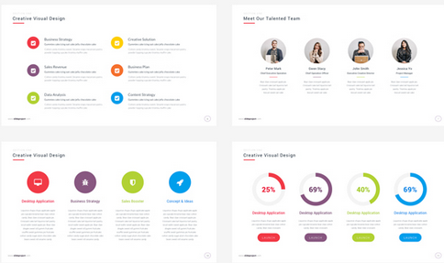
Health Partnership
Celebration event
Keeping children safe
Workshop 3
Health Improvement Team

Slide 2
Focus for today’s workshop:
Online risks
How you can keep your child safe
How you can set clear limits and rules
Support and resources

Slide 3


Using the internet is like driving a car
=
We must learn to use it safely

Slide 4

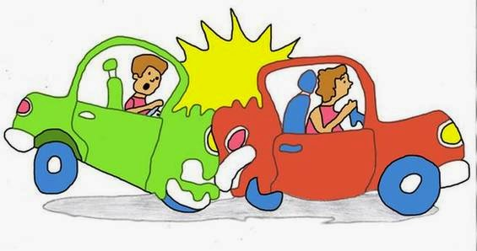
Using the internet
Freedom
Choice
Opportunities
If you don’t know how to use it properly
Dangerous
Scary
Hurt
Get out of control

Slide 5
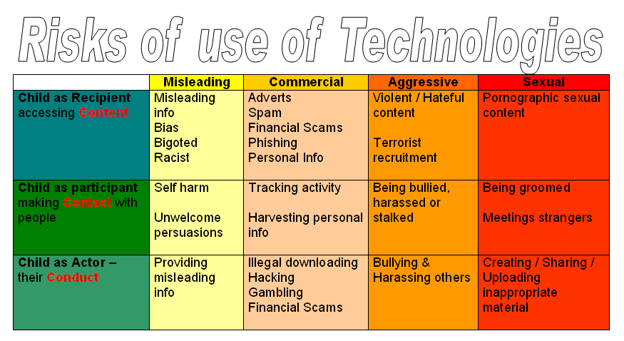
Nature of the risks
Notes:
Many risks - categorised in this chart _Ofsted refer to this clasification
Next 20 slides go through each level of risk ( column)
5

Slide 6
Content of Games
Taking Drugs
Violence
Killing
Sexism
Swearing
Torture
Guns
Monsters
Prostitution
Racism
Knifing
War
Zombies
Rape
Theft
Murder

Slide 7
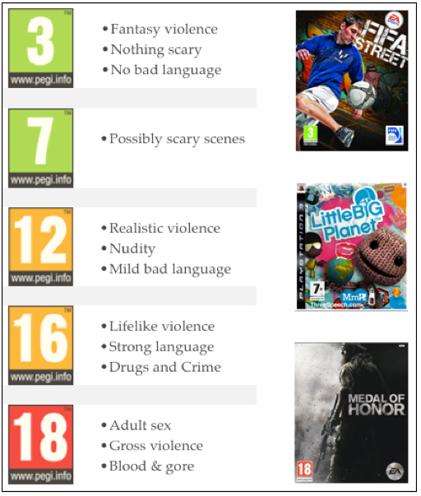

Content of Games
PEGI labels appear on front & back of the packaging.
They provide a reliable indication of the suitability of the game contents.
Notes:
PEGI age rating system

Slide 8
Online risks
Risk cannot be totally eradicated
“As safe as possible, for as many as possible, for as much of the time as possible”
Notes:
Risk cannot be eradicated – therefore ‘as safe as possible for as many as possible for as much of the time as possible’

Slide 9

What can you do?
Notes:
Risk cannot be eradicated – therefore ‘as safe as possible for as many as possible for as much of the time as possible’

Slide 10
T
TALK with your child about staying safe online.

Slide 11
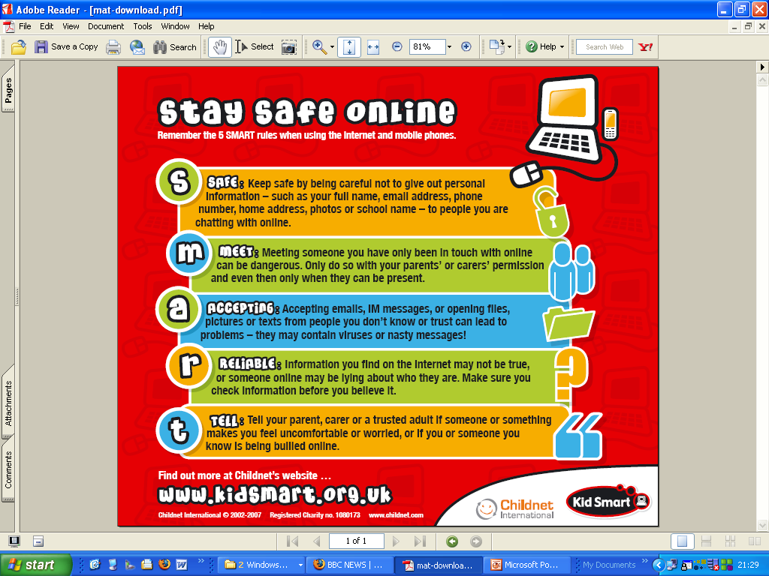
Guidance on e-Safety
Notes:
SMART acronym pervades almost everything

Slide 12
What you can do ? GOLDEN RULES
G = Ground rules
    What is OK / not OK
    What information should kept private
O = Online Safety
    Keep Antivirus & Spyware software up to date
    Other security protection
L = Location
    Keep computer in a busy area
    Not in the bedroom
D = Dialogue
    Talk with your children
    Learn from each other
Notes:
VIDEO - Golden Rules

Slide 13
E
EXPLORE their online world together.

Slide 14

Support for parents
Key websites
Share aware website
Home family guidelines
Setting limits
SMART rules
GOLDEN rules
Family agreement
Notes:
Risk cannot be eradicated – therefore ‘as safe as possible for as many as possible for as much of the time as possible’

Slide 15
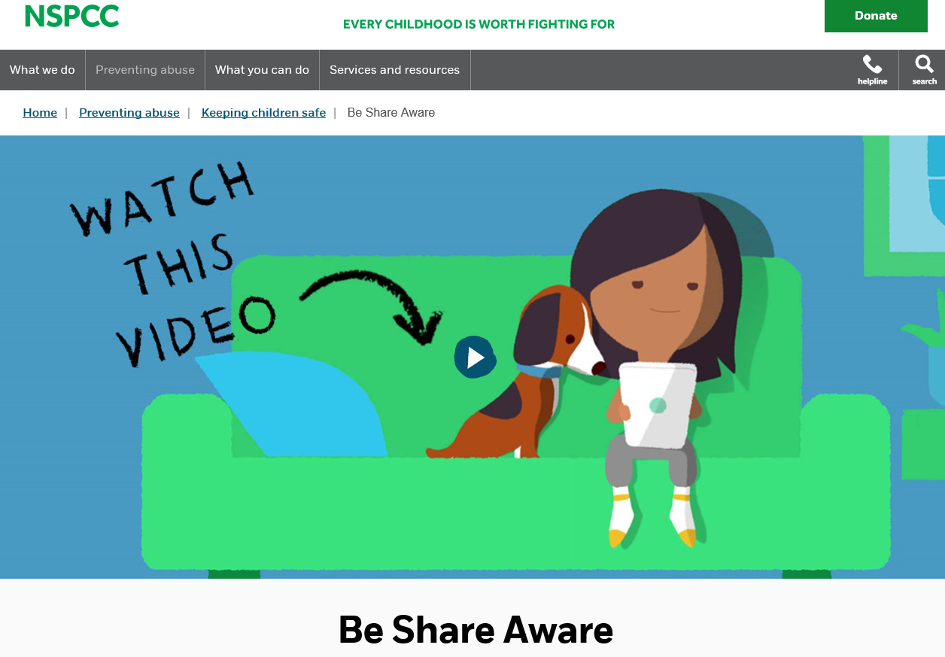
Notes:
SMART acronym pervades almost everything

Slide 16
What can you do?
Talk about what might be OK for children of different ages. Ask your child what sites or apps they like. Write a list, and look at them together.
Be positive about what you see, but also be open about concerns you have: "I think this site's really good" or "I'm a little worried about things I've seen here".
Notes:
Risk cannot be eradicated – therefore ‘as safe as possible for as many as possible for as much of the time as possible’

Slide 17
A
AGREE rules about what’s ok and not ok.

Slide 18

Family agreement
Notes:
Risk cannot be eradicated – therefore ‘as safe as possible for as many as possible for as much of the time as possible’

Slide 19

Clear guidelines and rules
Notes:
Risk cannot be eradicated – therefore ‘as safe as possible for as many as possible for as much of the time as possible’

Slide 20
Set clear limits
Discuss with your child.
Make a plan and set limits. Explain why these limits have been set.
Stick to your plan.
Review and assess.
Notes:
Risk cannot be eradicated – therefore ‘as safe as possible for as many as possible for as much of the time as possible’

Slide 21
M
MANAGE your family’s settings and controls.

Slide 23
Websites
Share Aware
Net Aware
Safer Internet Centre
CEOP
The Parent Zone

Slide 24
What do we teach the children?
Nursery: Uses of the internet, who to talk to if you are worried.
Reception: Uses of the internet, who to talk to if you are worried.
Year 1: Sharing personal information, who to talk to.
Year 2: Trusting what you see or who you talk to online, sharing personal information.
Notes:
Risk cannot be eradicated – therefore ‘as safe as possible for as many as possible for as much of the time as possible’

Slide 25
What do we teach the children?
Year 3: Trust and critical thinking, tips for keeping safe.
Year 4: Peer pressure online, digital footprint.
Year 5: Sharing online content, peer pressure and group messages.
Year 6: Manipulative peer pressure, sharing content and online friendships.
Notes:
Risk cannot be eradicated – therefore ‘as safe as possible for as many as possible for as much of the time as possible’

Slide 26
FGM
FGM and the Law
Safeguarding women and girls from FGM
Next workshop:

Slide 27
Future dates:

Slide 28

Questions

Slide 29







Thank you for attending!
Hoda Ali

