Slide 1

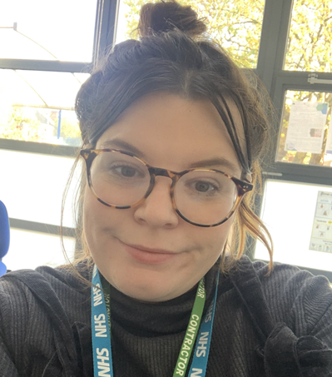
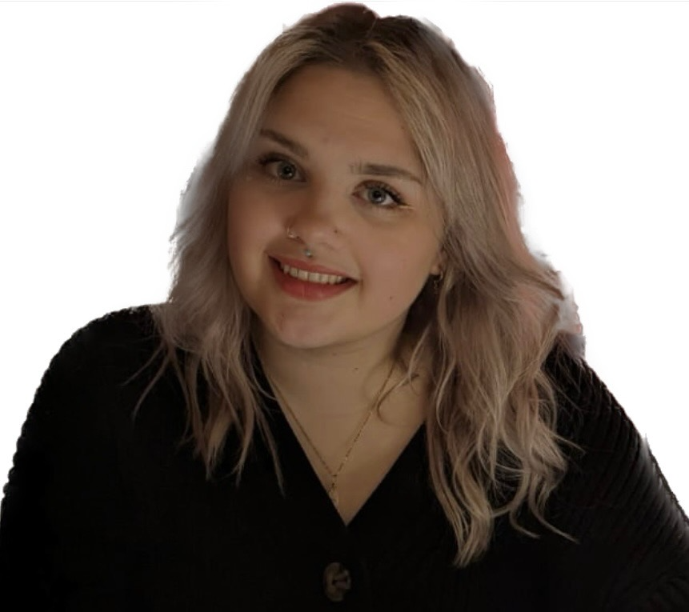
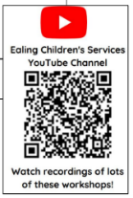
Ealing Speech and Language Therapy Team
Brentside Primary
Felicity Emmerson
Speech and Language Therapist
CORE SLT
Service for all children in EYFS and children with Social Communication needs and/or Speech Difficulties and/or Selective Mutism in Yr1+
Buy-in SLT
Email: wlm-tr.ealingschoolsslt@nhs.net
SLT admin: 0300 123 4544
Emily Stevens
Speech and Language Assistant
Website: www.westlondon.nhs.uk/ecp Find us on Facebook: https://www.facebook.com/SLTEaling

